Slide 1
Determining value with stakeholders
Dr Pauline Dickinson
Dr Jeffery Adams
Australasian Evaluation Society 2011
International Conference
Notes:
Introductions

Slide 2
Outline
Value in evaluation
Determining value
Practice exercises
Discussion
Notes:
This is a very time bound skills based session.
The purpose of the session is to show you a way to engage stakeholders in determining value.
We will have a brief discussion about value in evaluation, then ways of determining value. This will be followed by some practice exercises and end with a discussion.

Slide 3
Evaluation
It is the systematic determination of the quality or value of something (project, programmes, organisations) in order to take action
Notes:
3
Evaluation
“Systematic determination of the quality or value of something.
Merit – intrinsic value of something – often used interchangeably with Quality
Worth – the value of something to someone or an organisation – and often used instead of Value

Slide 4
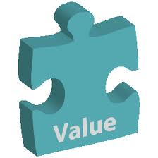
What is a ‘value’?
The worth, desirability or
utility of something
A judgement of what is
valuable or important
The Concise Oxford Dictionary
Notes:
Bring up title. In this next section we are going to look at “values”
Brainstorm onto the whiteboard--where do values come from?
So the term “value” refers to both the intrinsic worth of something AND the basis on which we determine the worth of something.
These two meanings are both important in the context of evaluation…we use values (from a range of sources) to determine the value of what we are evaluating

Slide 5
Why values are important
Help determine worth or quality
How quality and success has been determined
Notes:
Sources of value can be the needs assessment, ethical and legal standards and other relevant standards Davidson (2005) (more on this later).

Slide 6
Ways of determining value
Review literature
Stakeholder discussions
Identifying effective ways of working
Using expert judgement
Notes:
PAGE 33
Some ways that you can determine what is of high quality and value is to access literature relating to your project. For example, you may find that when you analyse your data that your findings are reasonably consistent with other research in the field or not, you can have discussions with stakeholders – it may be that some things end up being weighted more highly than others and this can help determine value. You also look at effective ways of working – for example, the literature may have identified that a project works best if it is operating at three different levels e.g., Health Promoting Schools work in Canada found that better results were achieved if initiatives addressed school environment, community and curriculum.

Slide 7
What is valued?
Establish criteria and standards
Collect data
Make evaluation judgement

Slide 8
Activity: Determining value

Slide 9
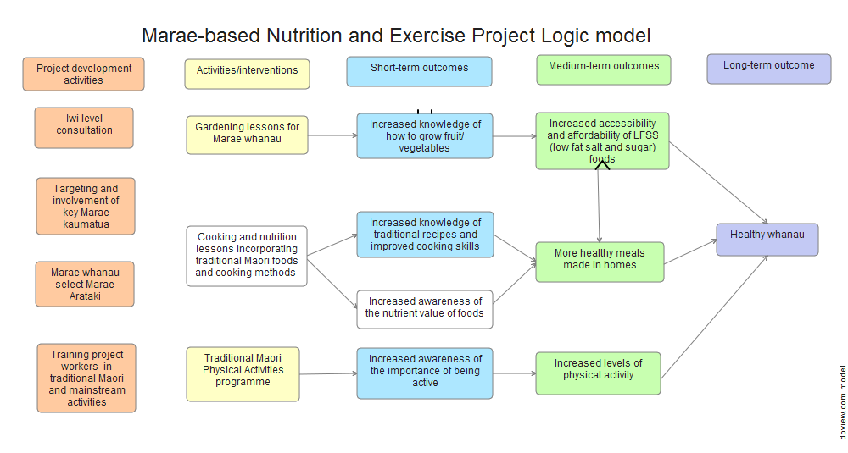

Slide 10
What does success look like? Outcome: Increased awareness of the nutrient value of foods
Notes:
PAGE 43
Now we are going to look at the evaluation criteria these are the attributes or features or components of a project activity that we look at to see how good or valuable or effective it is…just like you did in the chocolate chip cookie exercise….

Slide 11
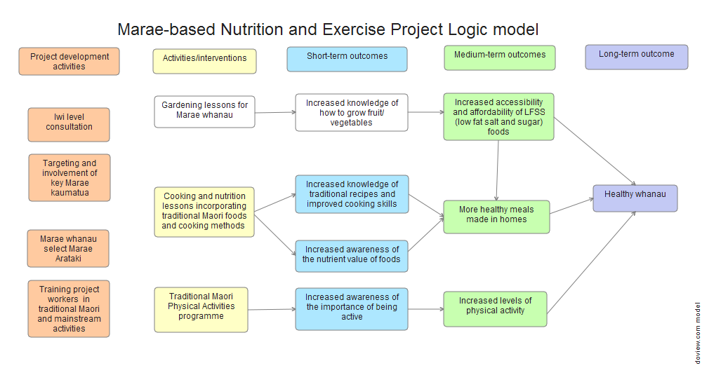

Slide 12
What does success look like? Outcome:: Increased knowledge of how to grow fruit and vegetables
Evaluation criteria | Data source | Method

Slide 13
Outcome: Increased awareness of the nutrient value of foods
Rating | Explanation (how you decide merit)
Excellent | All participants are able to identify the main food groups, state which foods are the best sources of certain key vitamins and minerals (e.g., iron, Vitamin C), and design a balanced, nutritious meal using fresh ingredients
Very Good | Most participants can do all of the above; most participants can design a reasonably nutritious meal, although they may not be able to explain which foods are high in key vitamins and minerals
Good | Over half of the participants can do all of the above and most of the participants can design a balanced, nutritious meal although they may not be able to explain which foods are high in key vitamins and minerals
Poor | Most participants are unable to distinguish between healthy and unhealthy foods, and are not able to design a meal that meets minimum nutritional standards

Slide 14
Outcome: Increased knowledge of how to grow fruit and vegetables
Rating | Explanation (how you decide merit)
Excellent
Very Good
Good
Poor
Notes:
Using whiteboard work up an example with the whole group

Slide 15
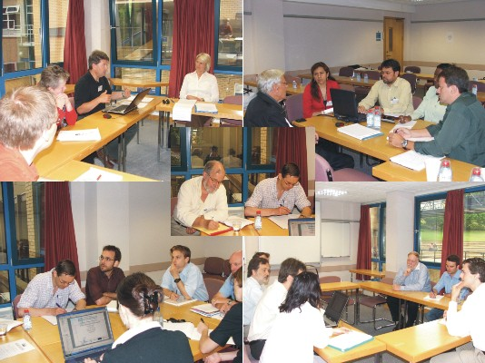
Activity: Discussion

Slide 16
Contact details
Pauline Dickinson – p.m.dickinson@massey.ac.nz
Jeffery Adams – j.b.adams@massey.ac.nz
SHORE and Whariki Research Centre
Massey University
Auckland, New Zealand
www.shore.ac.nz

Slide 17
Acknowledgements and references
Adams, J., & Dickinson, P. (2010). Evaluation training to build capability in the community and public health workforce. American Journal of Evaluation, 33(3), 421-433.
Davidson, E. J. (2005). Evaluation methodology basics: The nuts and bolts of sound evaluation. Thousand Oaks: Sage.
Fournier, D. M. (1995). Establishing evaluative conclusions: A distinction between general and working logic. New Directions for Evaluation, 1995(68), 15-32.
House, E. R., and Howe, K. R. (1999). Values in evaluation and social research. Thousand Oaks: Sage.

